Slide 1

Load Forecasting at UC Berkeley

Slide 2

Introduction
INTRODUCTION
Motivation
Predict daily electricity consumption for over 70 buildings at UC Berkeley
Objective
Build model on past 2016-2019 data to predict November 2019 electricity use
Create interactive dashboard
to display predictions for
all buildings

Slide 3






Methodology
METHODOLOGY
Data Collection
Modeling
Dashboard
Scrape data from UCB open data source
Impute missing data
Exploratory Data Analysis
Train baseline model on single building’s data
Apply to other buildings, tune models as needed
Build dashboard to display load forecasts for all buildings.

Slide 4
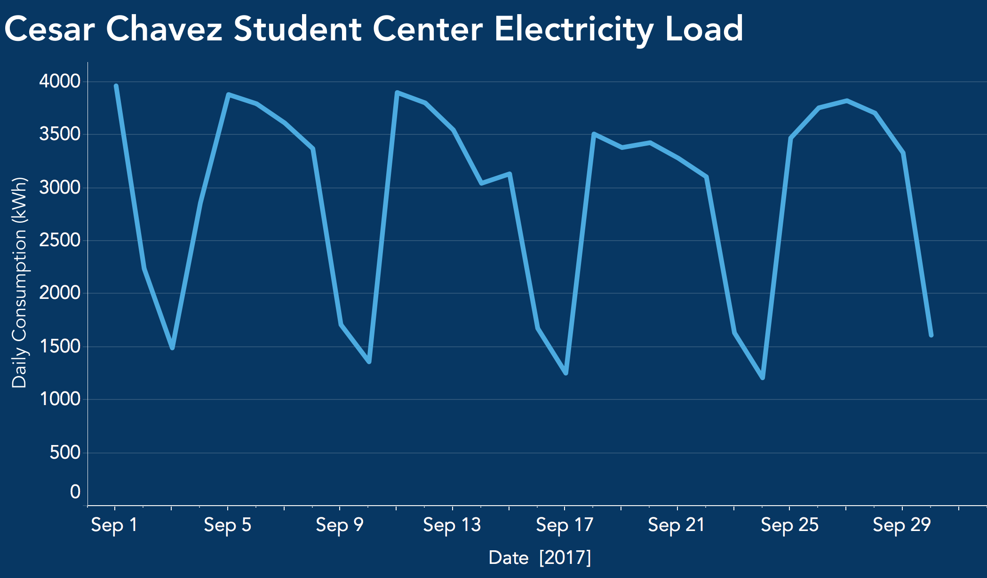
Exploratory Data Analysis

Slide 5
Exploratory Data Analysis
Weekdays

Slide 6
Exploratory Data Analysis
Weekdays
Weekends

Slide 7
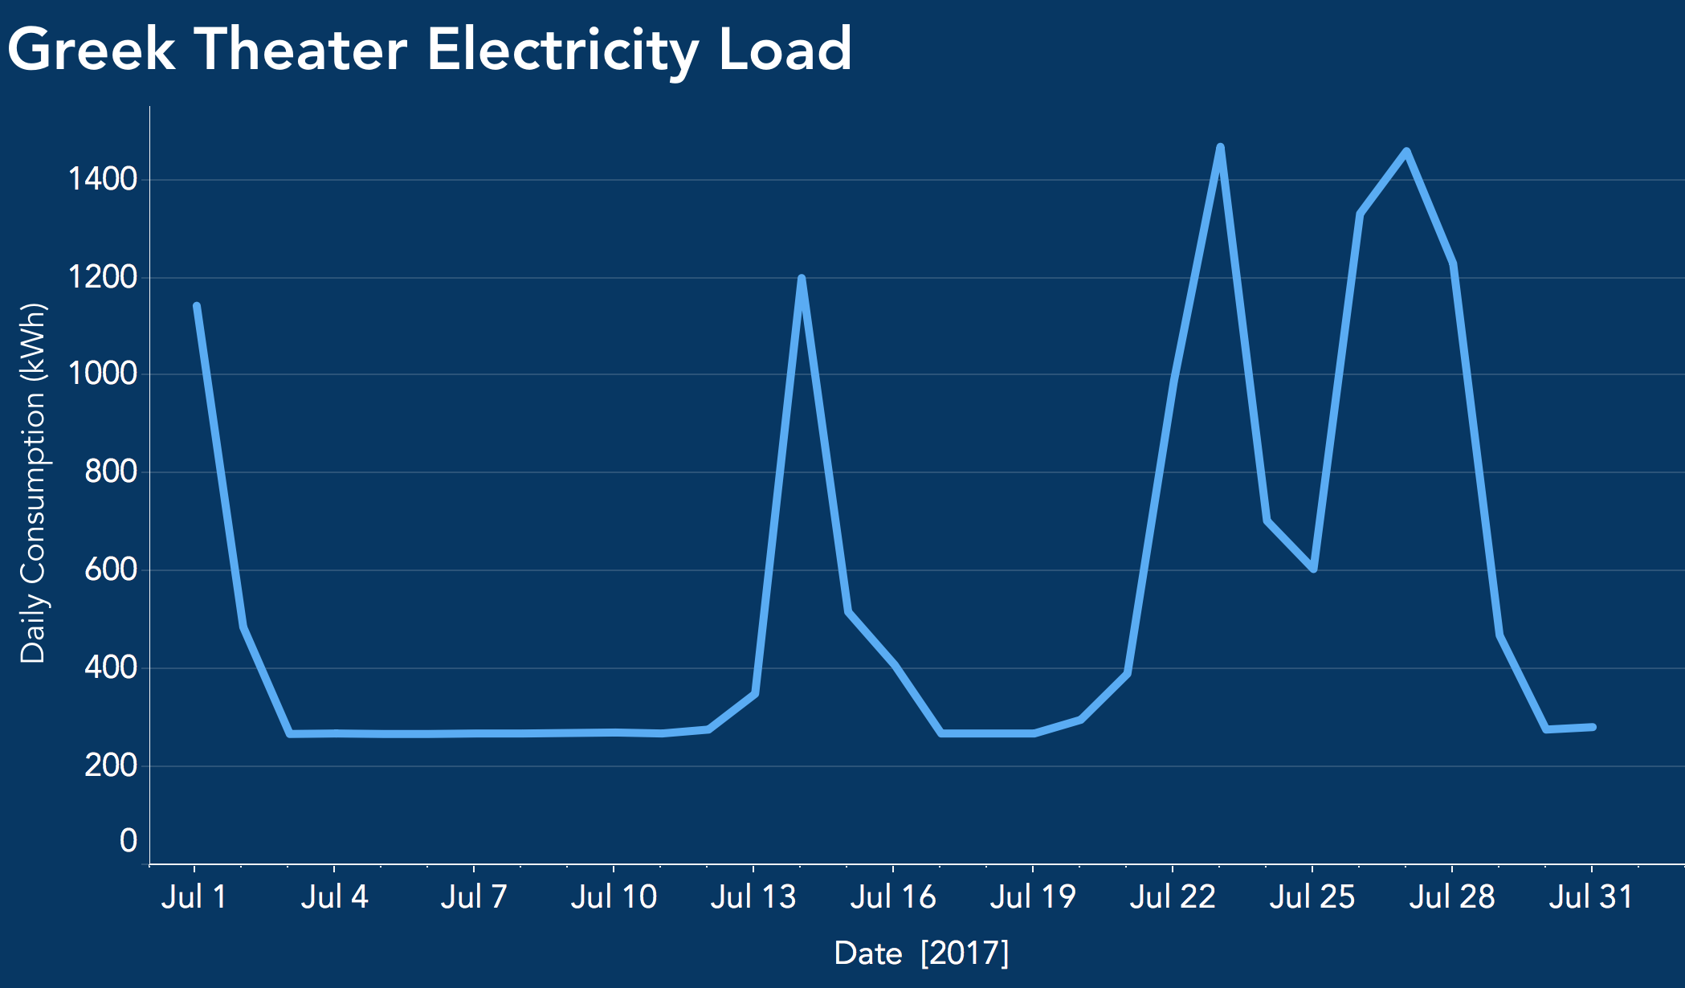
Exploratory Data Analysis

Slide 8
Exploratory Data Analysis
Events

Slide 9
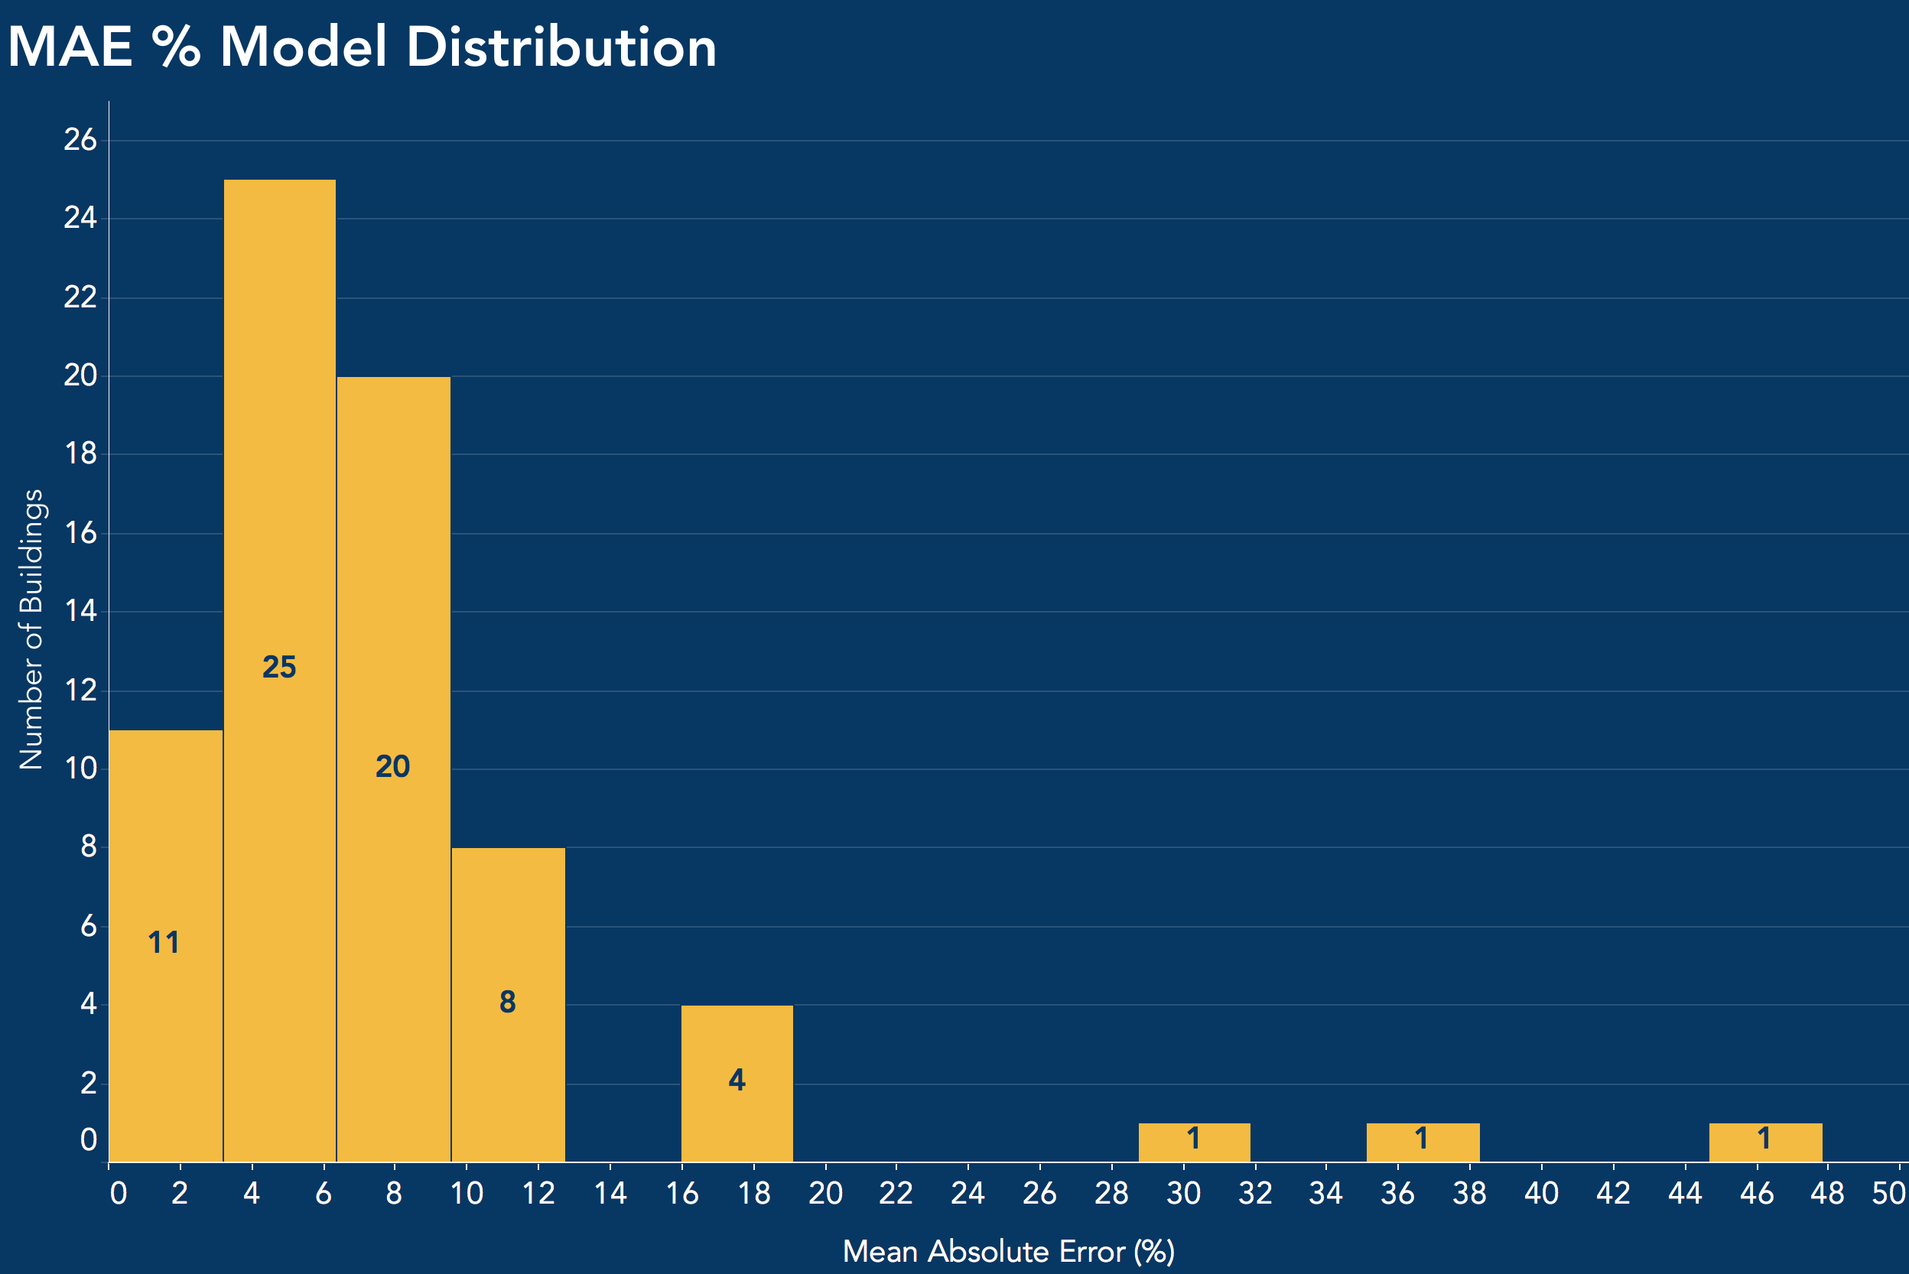
Results

Slide 10
Results
~10% mean absolute error or less for 90% of modeled buildings
3 outlier buildings have electricity consumption that is harder to predict

Slide 11
Results
~10% mean absolute error or less for 90% of modeled buildings
3 outlier buildings have electricity consumption that is harder to predict

Slide 12
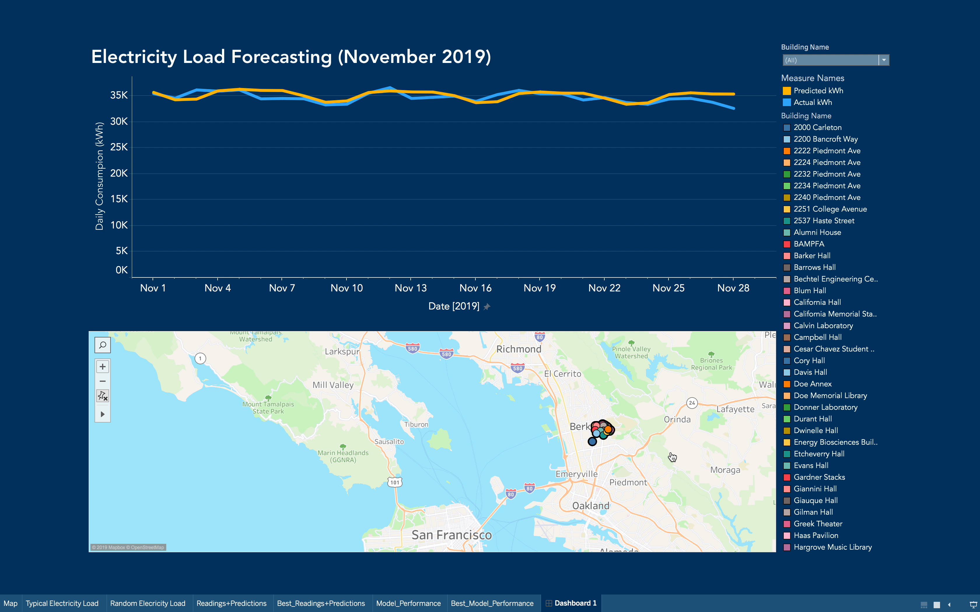

Slide 13
Conclusion
Recommendations
Dashboard can be used by maintenance personnel to monitor electricity consumption, set monthly expectations, catch irregular patterns, etc.
Future Work
Look into more complex models for buildings with volatile electricity use (e.g. Garch)
Gather more data to add as
exogenous variables, observe
their effect on predictiveness

Slide 14
Questions?

Slide 15
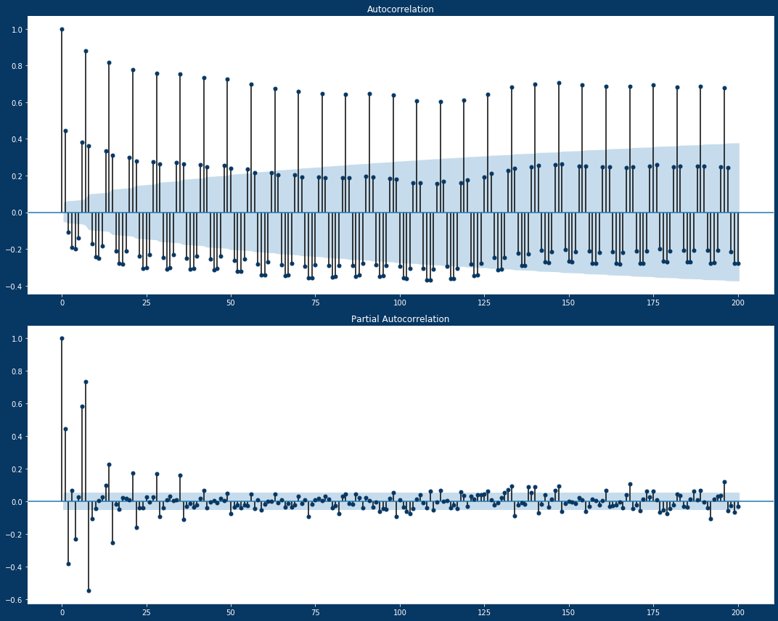
Appendix

